Slide 1
Object Oriented Programming
LAB # 5

Slide 2
Operator Overloading
The process of defining additional meanings of an operator is known as operator overloading.
It enables the operator to perform different operations depending on the type of operands.
It also enables the operators to process the user-defined data types.
The basic arithmetic operators such as +,-,* and / normally work with basics types such as int, float, and long etc.
An operator can be overloaded to process the user-defined objects.

Slide 3
Overloading an Operator
An operator can be overloaded by declaring a special member function in the class.
The member function uses the keyword operator with the symbol of operator to be overloaded.
Syntax:
return_type operator op ( )
{
function body;
}

Slide 4
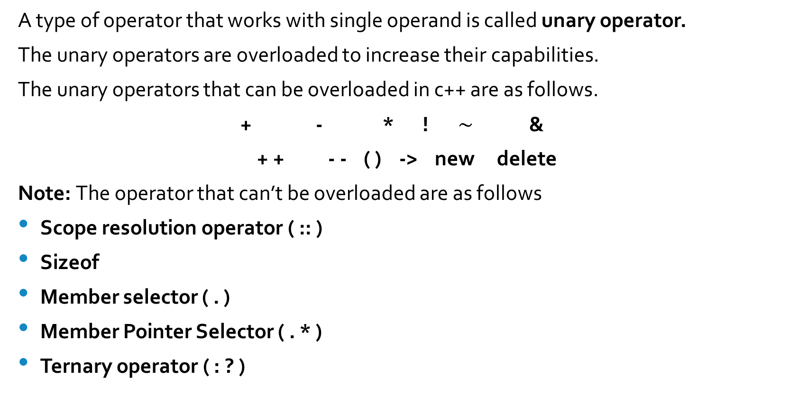
Overloading Unary Operator
A type of operator that works with single operand is called unary operator.
The unary operators are overloaded to increase their capabilities.
The unary operators that can be overloaded in c++ are as follows.
+ - * ! $\sim$ &
+ + - - ( ) -> new delete
Note: The operator that can’t be overloaded are as follows
Scope resolution operator ( :: )
Sizeof
Member selector ( . )
Member Pointer Selector ( . * )
Ternary operator ( : ? )

Slide 5
Overloading ++ Operator
The increment operator ++ is a unary operator. It works with single operand.
It increases the value of operand by 1.
It only works numeric values by default.
It can be overloaded to enable it to increase the values of data members of an object in the same way.

Slide 6
Write a program that overloads increments operator to work with user-define objects:
class Counter
{
private:
unsigned int count;
public:
Counter() : count(0) { }
unsigned int get_count()
{
return count;
}
void operator ++ ()
{
++count;
}
};
int main()
{
Counter c1, c2;
cout << “\nc1=” << c1.get_count();
cout << “\nc2=” << c2.get_count();
++c1;
++c2;
cout << “\nc1=” << c1.get_count();
cout << “\nc2=” << c2.get_count();
return 0;
}
Output:
c1 = 0
c2 = 0
c1 = 1
c2 = 2

Slide 7
Operator Overloading with Returned Value
The increment operator can be used in assignment statement to store the incremented value in another variable.
Suppose a and b are two integers, the following statement will increment the value of a by 1 and then assign the new value to b.
b = ++ a ;
The above functionality can be assigned to the operator by returning the new value from the member function.
The returned value can be stored in another object of the same type on the left side of the assignment operator.

Slide 8
Task: Write a program that overloads the increment operator to work with user-defined objects. The overloaded function should return an object after incrementing the data member.

Slide 9
class Counter
{
private:
unsigned int count;
public:
Counter() : count(0) { }
unsigned int get_count()
{
return count;
}
Counter operator ++ ()
{
++count;
Counter temp;
temp.count = count;
return temp;
}
};
int main()
{
Counter c1, c2;
cout << “\nc1=” << c1.get_count();
cout << “\nc2=” << c2.get_count(); ++c1;
c2 = ++c1;
cout << “\nc1=” << c1.get_count();
cout << “\nc2=” << c2.get_count() << endl;
return 0;
}
Output:
c1 = 0
c2 = 0
c1 = 2
c2 = 2

Slide 10
Overloading Binary Operator
A type of operator that works with two operands is called binary operator.
The binary operators are overloaded to increase their capabilities.
The Binary operators that can be overloaded in c++ are as follows:
+ - * / % & | ^ << >>
== += -= /= %= &= |= ^= <<= >>=
> < <= >= && || [ ] ( )

Slide 11
Arithmetic Operator
The Binary arithmetic operators such as +, - , * , / are binary operators.
They works with two operands.
These operators can be overloaded to enable them to work with user-defined objects in the same way as they work with basic types such as int, long and float etc.

Slide 12
Class Add
{
private:
int a, b;
public:
Add ( )
{ a = b = 0 ; }
void in ( ) {
cout<< “ Enter the value of a “ ;
cin>> a ;
cout<<“Enter the value of b “ ;
cin>>b; }
void show ( ) {
cout<< “ a “ <<a <<endl;
cout<<“b ” <<b <<endl ; }
Add operator + ( Add p )
{
Add temp;
temp.a = p.a + a ;
temp.b = p.b + b ;
return temp;
}
void main ( )
{
Add X , Y , Z ;
X. in ( ) ;
Y . in ( );
Z = X + Y ;
X . show ( ) ;
Y . show ( ) ;
Z. show ( ) ;
}

Slide 13
Overloading Comparison Operator
The comparison operator are Binary Operators.
These operators are frequently used to compare the values of basic data types.
Suppose a and b are two integers and the following statement is execute
a == b
The above statement is true when a and b values are equal otherwise false.
The comparison operator == can’t work with user-define objects, but It can be overloaded in order to use it with user-define objects.

Slide 14
Task: Write a program that overloads the comparison operators == to work with String class. The result of comparison must be 1 if two strings are of same length and 0 otherwise.

Slide 15
class String
{
private:
char str [50];
public:
String()
{ str[0] = '\0’; }
void in () {
cout<< "Enter string ";
cin>>str; }
void show () {
cout<<str<<endl; }
int operator == (String s)
{
if ( strlen(s.str)==strlen(str))
return 1;
else
return 0;
}
};
main ()
{
String s1, s2;
s1.in();
s2.in();
cout<<"s1 = " ;
s1.show();
cout<<"s2 = ";
s2.show();
if(s1==s2)
{
cout<<"Both strings have equal legth ";
}
else
{
cout<<"Both strings have different length ";
}
}

Slide 16
Overloading Assignment Operator
The arithmetic assignment operations are used to increase the value of a variable.
Suppose a and b are two integers and the following statements is executed.
A +=B
The above statement will add the values of a and b and assign the result to a.
The arithmetic assignment operator += can’t work with user-defined objects, but it can be overloaded in order to use it with user-defined objects.

Slide 17
Test operator++()
{
a++;
b++;
Test temp;
temp.a=a;
temp.b=b;
return temp;
}
void display()
{
cout<<"\nValue of a = "<<a;
cout<<"\nValue of b = "<<b;
}
};
int main()
{
Test t1(20,30),t2(40,60), t3;
t3=++(t1+t2*t2);
t1.display();
t2.display();
t3.display();
}
class Test
{
int a, b;
public:
Test():a(0),b(0)
{ }
Test(int x, int y):a(x),b(y)
{ }
Test operator+(Test t)
{
Test temp;
temp.a=a+t.a;
temp.b=b+t.b;
}
Test operator*(Test t)
{
Test temp;
temp.a=a*t.a;
temp.b=b*t.b;
return temp;
}

Slide 18
Task:
Define a class for a bank account that includes the following data members:
Name of the depositor
Account number
Type of account
Balance amount in the account
The class also contains the following member functions
A constructor to assign initial values
Deposit function to deposit the some amount, it should accept the amount as parameter.
Withdraw function to withdraw an amount after checking the balance. It should accept amount as parameter.
Display function to display the name and balance.
Overload binary + operator that adds the balance of one account to another account. It should accept an object as parameter and add the values of the parameter to the calling object.

